Slide 1
Hebrew rhythm class
A study of Hebrew rhythm class across languages

Slide 2
The aim
To demonstrate that Hebrew fall in the stress-time rhythm pattern continuum
To show a quantified method to measure rhythm pattern continuum
To show that proficiency …

Slide 3
Rhythm class typology
Morse code rhythm” and “machine gun rhythm” (Lloyd James, 1940, p. 25),in reference to the short (dot) and long (dash) pattern of Morse
Isochrony hypothesis (Abercrombie, 1967; Pike, 1945).
Dauer (1983) :syllable-timed displayed little or no vowel reduction and restricted consonantal phonotactics, in contrast to stress-timed, high level of vowel reduction (i.e. a predominance of schwas)

Slide 4
Rhythm class in language acquisition: discrete categories or gradient variation?
L1
L2
authors | goal | methodology | results
Rathcke and Smith (2015) | to explore the acoustic bases of the rhythmic typologies deriving from the rhythm class | two varieties of Yorkshire British English | The results strongly suggest that –rather than sensitivity to discrete classes –discrimination reflects exploitation of gradient prosodic difference

Slide 5
The linguistic phenomenon
language | syllable structure | phonological vowel reduction | acoustic correlates of stress
English | up to three consonants in the onset (straight) up to four in the coda (e.g., twelfths) | phonological vowel reduction in unstressed syllables | stress affects vowel duration: vowels in stressed syllables are longer than in unstressed syllables
Spanish | up to two consonants are in the onset (e.g., criar) up to two in the coda (e.g., vals) | Ø | The effect is lower in Spanish
Hebrew | Up to one in the onset ( e.g sefer) Up to one in the coda, except 2 p.s suffix ( katabt)

Slide 6
The current study
The present study attempts to demonstrate phonological similarities, namely rhythm class, between Hebrew and English comparing vowel duration between:
L1 Hebrew and L1 English L2 Hebrew learners
L1 Spanish and L1 English L2 Spanish learners
It aims to examine data from L1 English who are learning an L2 language with no clear rhythm class classification –Hebrew- and to examine L1 English who are learning a well-known syllable time language, Spanish, that differ from English rhythm class- stress time.
Also the present work examines whether proficiency is a good predictor of vowel duration similarities or differences between L2 groups.

Slide 7
Research questions and hypotheses
RQs
Hypotheses
Does Hebrew fall in the stress-time rhythm pattern continuum alike English?
Does proficiency modulate differences in vowel duration between L1 Spanish and L1 English L2 Spanish learners and between L1 Hebrew and L1 English L2 Hebrew learners ?
Hebrew contains suprasegmental features that are part of the classification of stress-time rhythm.
Proficiency has an affect in vowel duration between L1 and L1 who belong to different rhythm class

Slide 8
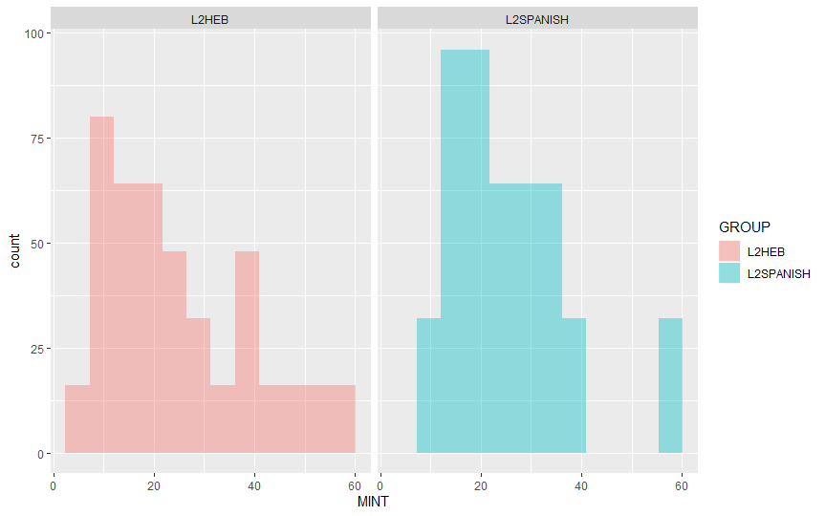
Participants
Comparison group
Experimental group
32 English Native L2 Spanish learners from Rutgers University
32 English native L2 Hebrew learners from Rutgers University and the Jewish Theological Seminary (JTS)
They have learned the target languages in an instructional context.
All of them are sequential bilinguals
32 adult Spanish-English bilingual from Universidad de Playa Ancha, Chile
32 adult Hebrew-English bilingual speakers from Tel Aviv University, Israel
They were all born and have lived in their home countries most of their lives
All of them are sequential bilinguals
no significant differences between means by group
(t = 0.32416, df = 838.82, p-value = 0.7459)

Slide 9
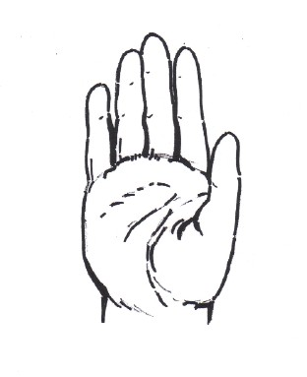
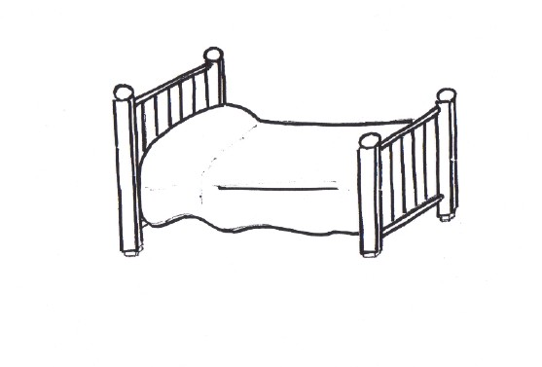
Materials
Selection of 8 items from MINT for each language produced by the participants
The selection include eight disyllabic items in Spanish and Hebrew
The first syllable no coda,
Segmentation in PRAAT

Slide 10
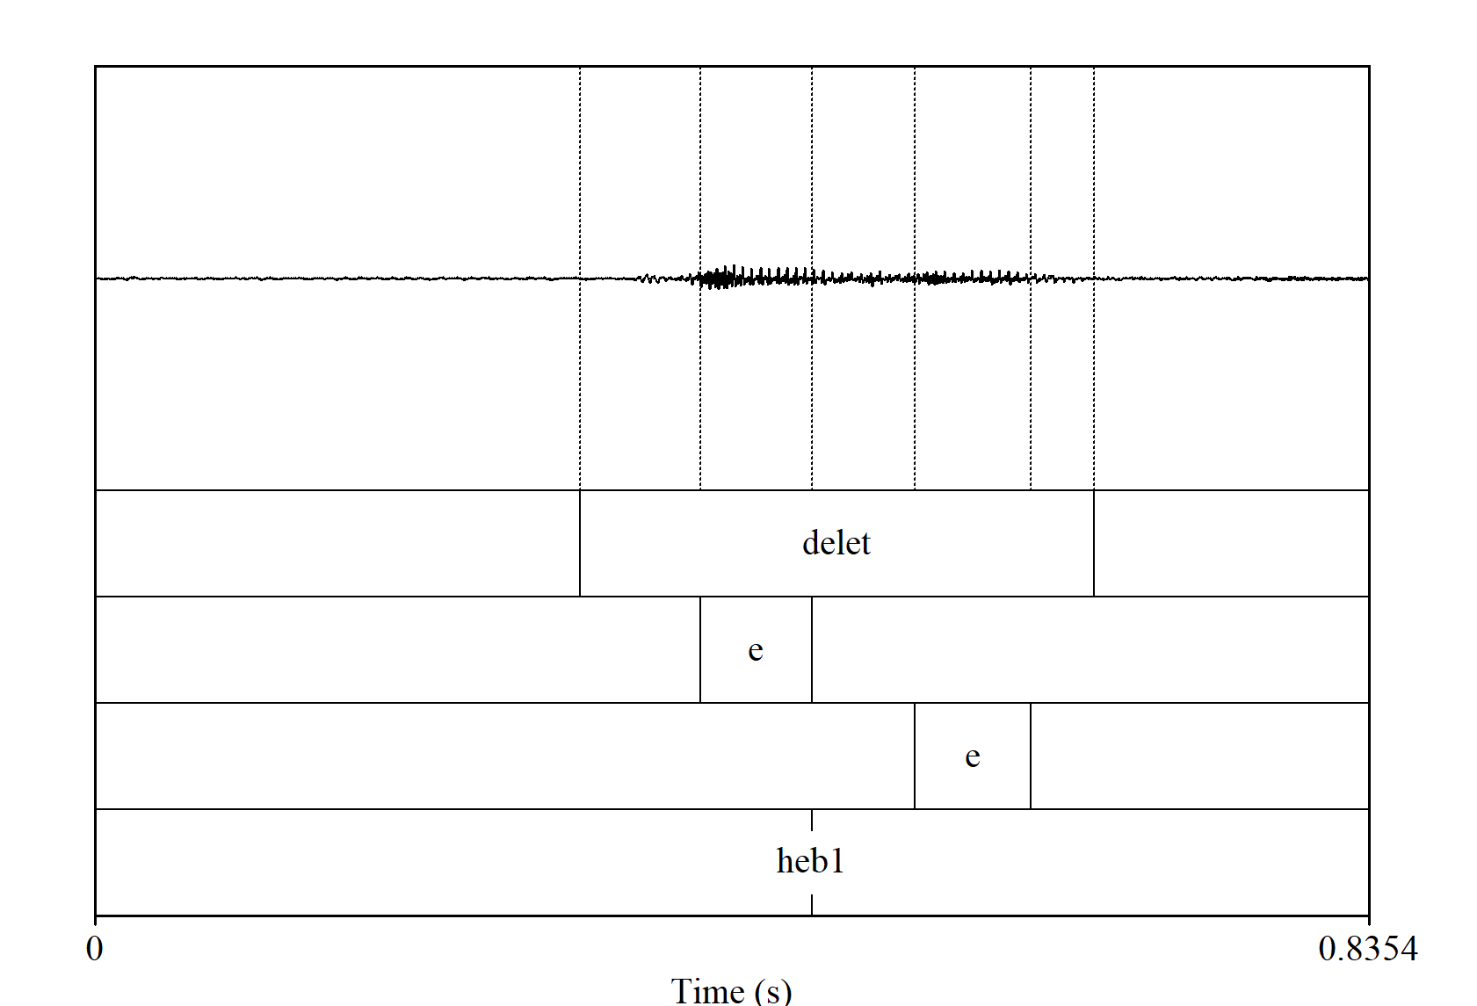
Procedure
Segmentation in PRAAT
3 tiers:
Word
Vowel1
Vowel2
1 point tier:
Language: HsEB1-HEB2/ SP1-SP2

Slide 11
Results

Slide 12
Descriptive statistics
Vowel 1 duration
Vowel 2 duration
langauge | type_lan | mean_v1 | sd_v1
HEB | L1 | 0.071 | 0.026
HEB | L2 | 0.073 | 0.029
SPAN | L1 | 0.063 | 0.019
SPAN | L2 | 0.079 | 0/020
langauge | type_lan | mean_v2 | sd_v2
HEB | L1 | 0.083 | 0.037
HEB | L2 | 0.092 | 0.036
SPAN | L1 | 0.058 | 0.021
SPAN | L2 | 0.091 | 0.031

Slide 13
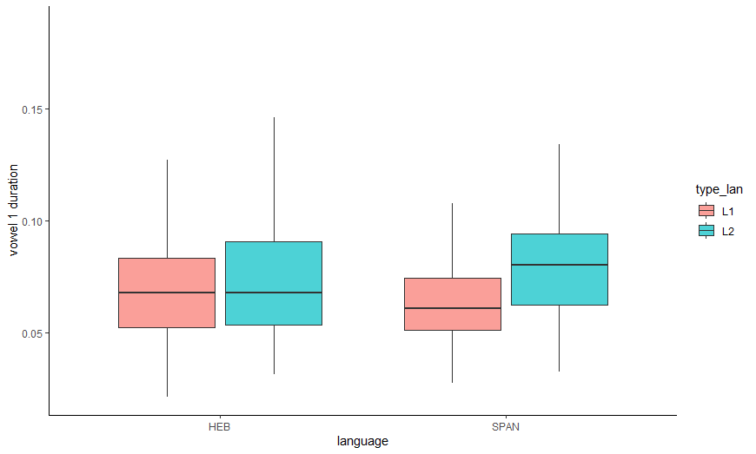
Vowel 1 by type of language
Linear model 1 and 2
Vowel | Language | Significance
vowel1 | Hebrew | p > 0.05
vowel 1 | Spanish | p < 0.01

Slide 14
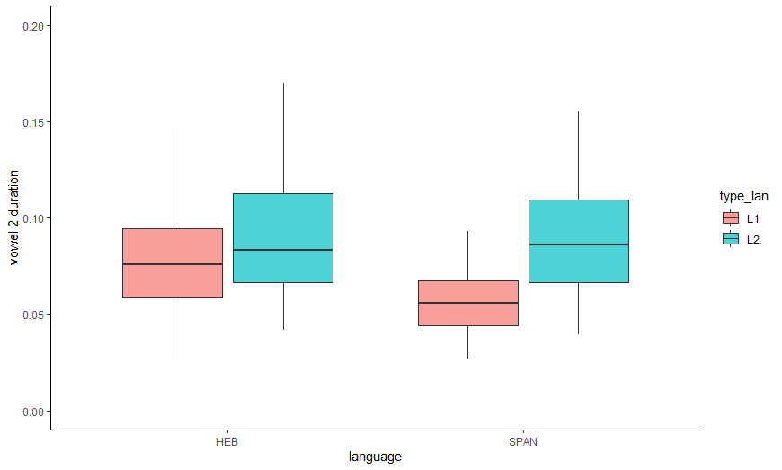
Vowel 2 by type of language
Linear model 3 and 4
Vowel | Language | Significance
Vowel 2 | Hebrew | p = 0.05
vowel 2 | Spanish | p < 0.01

Slide 15
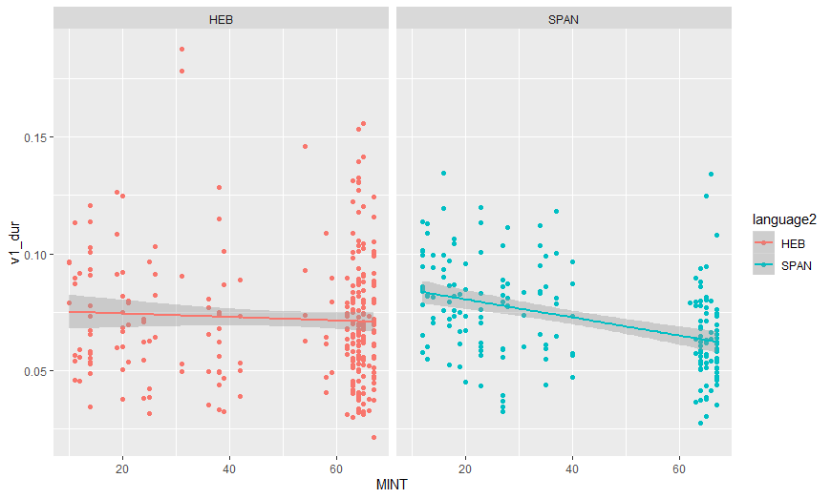
Vowel 1 by proficiency (MINT)
Linear model 5 and 6
Vowel 1 by MINT | Language | Significance
Vowel 1 | Hebrew | p = 0.365
vowel 1 | Spanish | p < 0.01

Slide 16
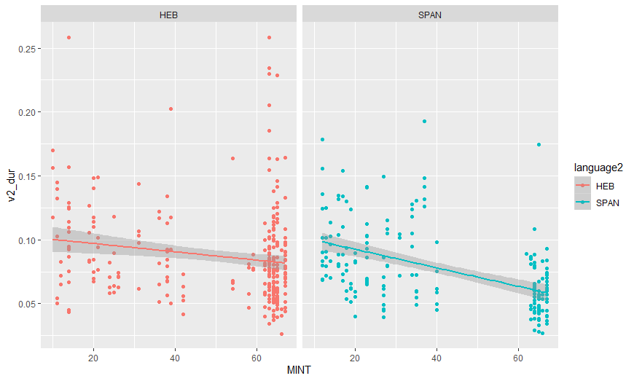
Vowel 2 by proficiency (MINT)
Linear model 7 and 8
Vowel 2 by MINT | Language | Significance
Vowel 2 | Hebrew | p = 0.03
vowel 2 | Spanish | p < 0.01

Slide 17
Conclusions

